Slide 1

Trend Trackers
MGMT 571 Data Mining
Muskan Aggarwal Ayush Gupta
Kaushalya Naidu

Slide 2
Overview
Final Model
2nd Best Model
Data Exploration
Data Transformation
Model Testing
Hyperparameter Tuning
Final Model

Slide 3
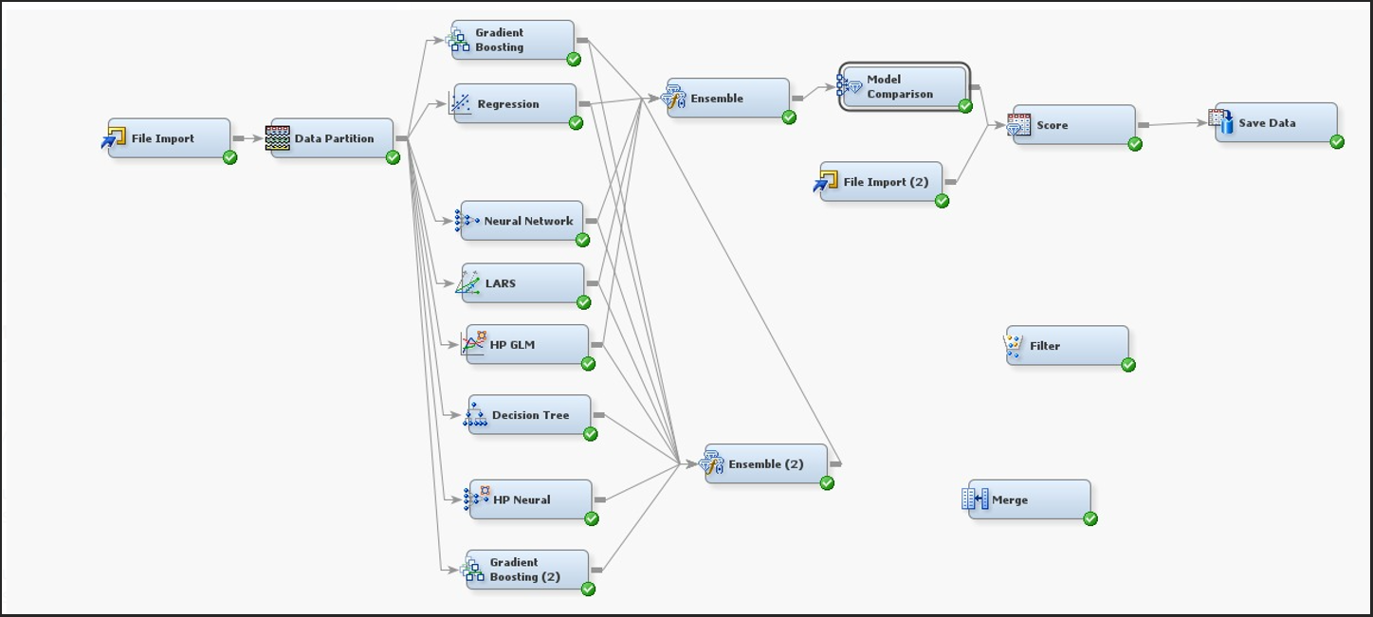
Final Model
ROC: 0.936 , Private Leaderboard Accuracy: 94.696
Decision Tree Node: Provides interpretable rules and quick insights, forming a strong baseline for classification and segmentation.
Gradient Boosting Node: Adds robustness by addressing residual errors and enhancing predictive accuracy through sequential learning.
Regression Node (Polynomial Forward Logistic): Captures nonlinear trends in binary classification, improving prediction reliability for key targets.
Neural Network Node: Brings flexibility and power to model complex relationships and interactions in the data.
HP Neural Node: Scales neural network capabilities to large datasets, ensuring rapid training and generalization in a distributed environment.
HP GLM Node: Handles count and continuous data with advanced distributional assumptions, enriching the model’s ability to predict skewed or over-dispersed outcomes.
LARS Node (Adaptive LASSO): Ensures sparsity and focus by selecting only the most impactful variables, reducing overfitting and improving interpretability.
Ensemble Node: Unifies diverse modeling techniques, combining their strengths to deliver a highly accurate and robust final prediction.

Slide 4
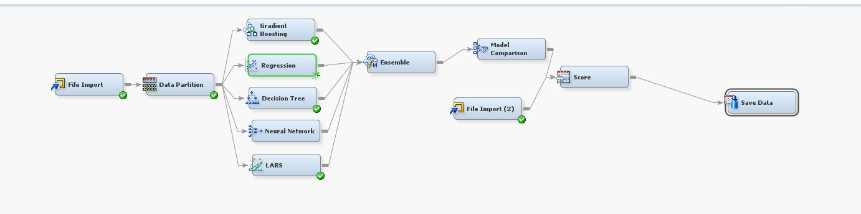
2nd Best Model
ROC: 0.922

Slide 5
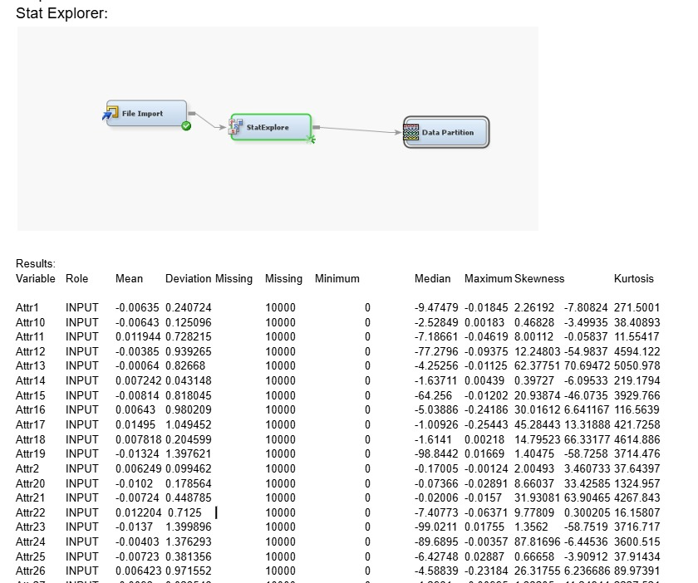
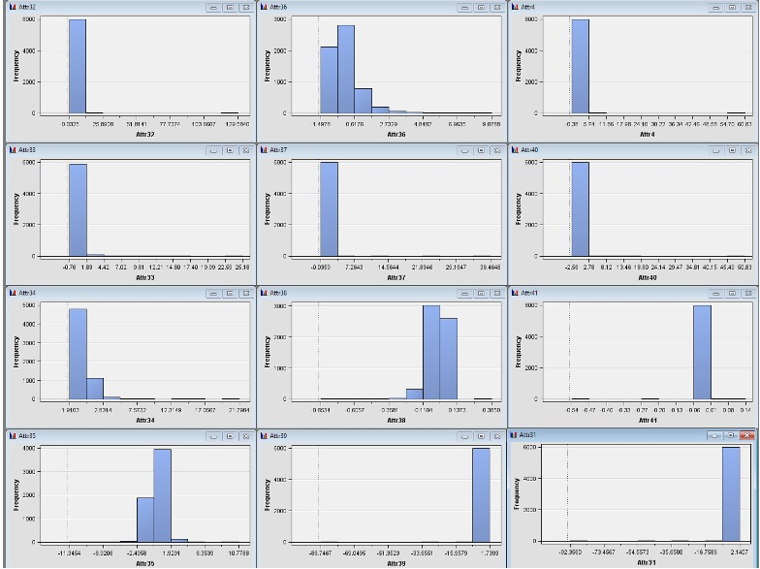
Data Exploration
Stat-Explore Node 1. Imputation- no missing values found 2. Data Distribution- To check skewness of the Variables.

Slide 6
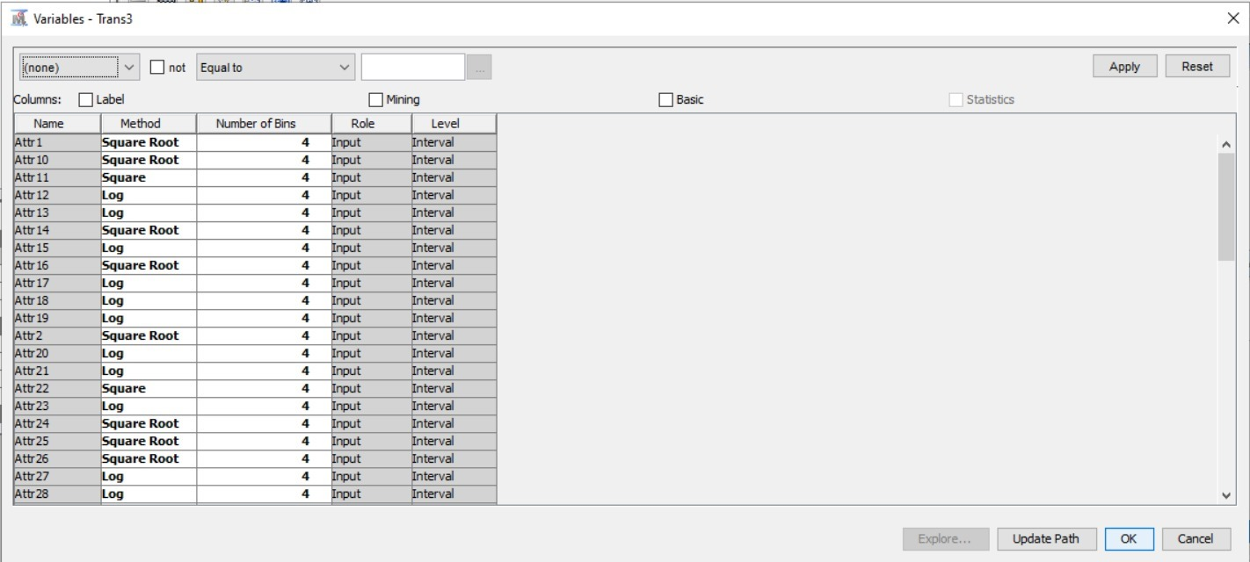
Data Transformation
Transform Variables Node Skewness Categories:
Skewness < -10: Attr12, Attr15, Attr19, Attr23, Attr31, Attr39, Attr41, Attr42, Attr45, Attr49, Attr5, Attr56, Attr57
Skewness > 10: Attr13, Attr17, Attr18, Attr20, Attr21, Attr27, Attr28, Attr30, Attr32, Attr37, Attr4, Attr40, Attr43, Attr44, Attr46, Attr47, Attr52, Attr53, Attr54, Attr55, Attr58, Attr59, Attr6, Attr60, Attr61, Attr62, Attr64, Attr8
1 <= Skewness <= 10: Attr16, Attr2, Attr26, Attr33, Attr34, Attr36, Attr50, Attr51, Attr63, Attr9
-10 <= Skewness < -1:Attr1, Attr10, Attr14, Attr24, Attr25, Attr3, Attr38, Attr48, Attr7

Slide 7
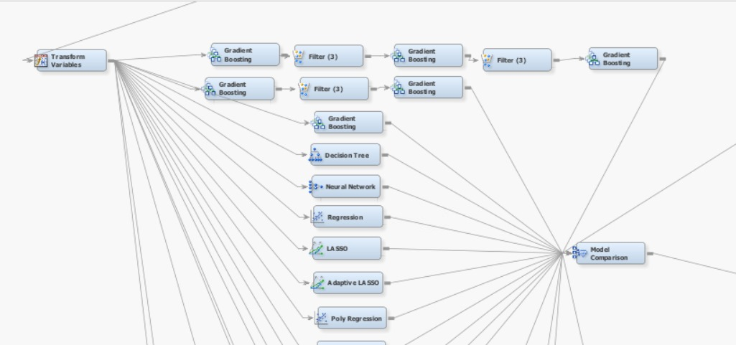
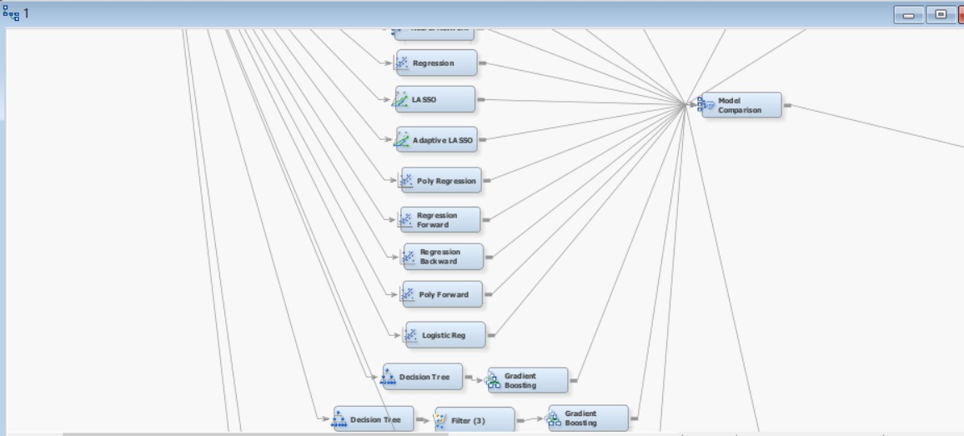
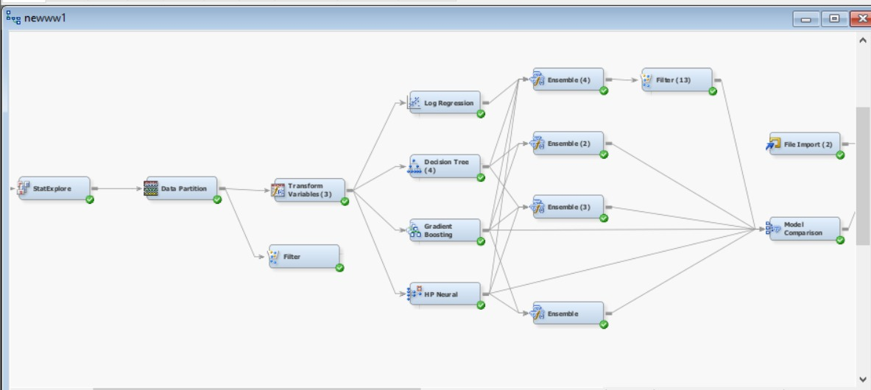
Model Testing

Slide 8
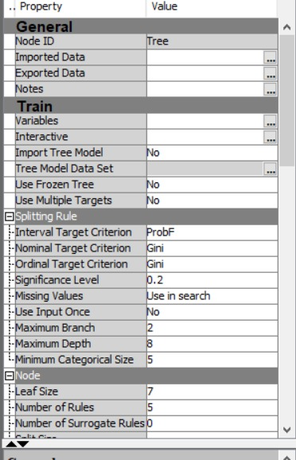
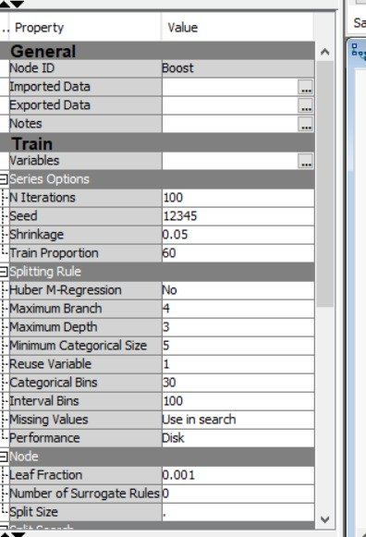
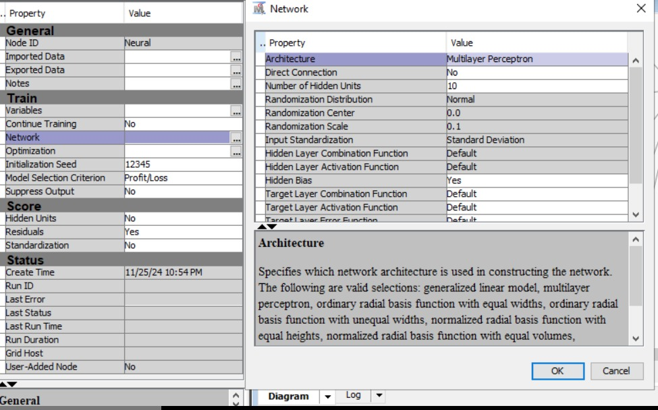
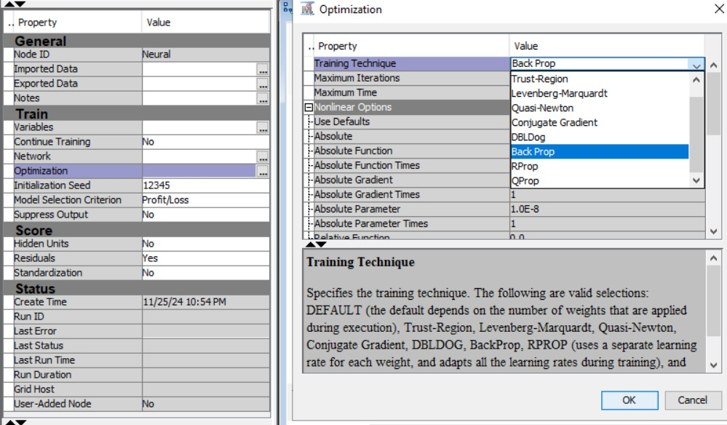
Hyperparameter Tuning
Decision Tree
Gradient Boost
Neural Network
Neural Network

Slide 9
Final Model

Slide 10
Thank you

